Slide 1
IP/DNS/Mac Address
By
Ramin Tajwanchi

Slide 2
IP ( Internet Protocol) Address:
→ An IP address, or simply an "IP," is a unique address that identifies a device on the Internet or a local network. It allows a system to be recognized by other systems connected via the Internet.
→ It uses a 32-bit address space, 16 bits for your network and 16 bits for the host.

Slide 3


→ IPv4 was the first version deployed for production in 1983
→ Every IP address—such as 76.240.249.145—is divided into two sections that define 1) your network and 2) your computer, or host.

Slide 4
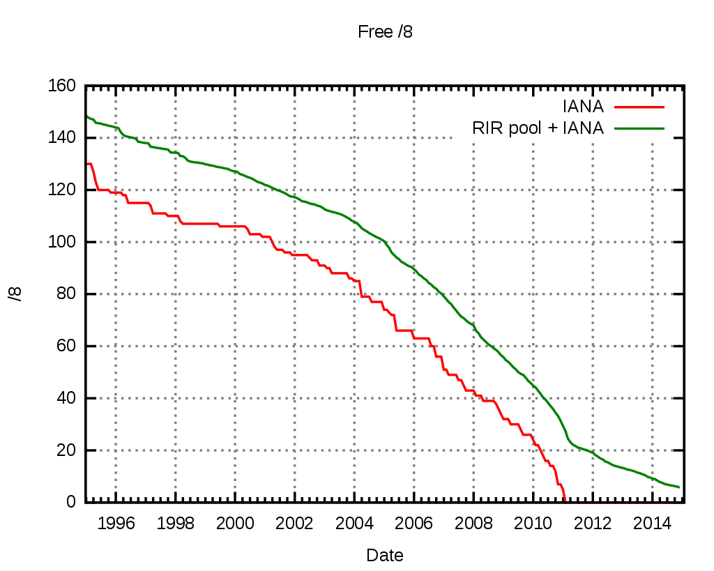
→ Believe it or not, we eventually started running out quickly…
→ Thankfully, a better and significantly bigger version was around the corner!

Slide 5

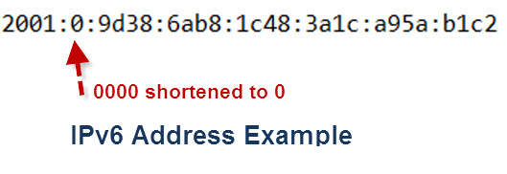
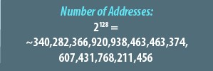
→ Was invented in 1998
→ Uses a 128-bit address, theoretically allowing2^128
Addresses
→ Can support all of our IP needs for a long period of time

Slide 6
Virtual Private Network (VPN):
→ A program that creates a safe, encrypted connection over a less secure network, such as the public internet.
→ Creates a point-to-point connection that cannot be accessed by unauthorized users.

Slide 7
Domain Name Servers (DNS) :
→ Is the phonebook of the Internet.
→ Humans access information online through domain names, like bbc.com or cbc.com. Web browsers interact through Internet Protocol (IP) addresses. DNS translates domain names to IP addresses so browsers can load Internet resources.

Slide 8
Media Access Control address (MAC address)
→ The MAC address is manufactured into every network card, such as an Ethernet card or Wi-Fi card, and therefore cannot be changed.
→ Is a hardware identification number that uniquely identifies each device on a network.

Slide 9

From Ramin
THANKS FOR COMING!

